Slide 1
Introduction to Information Theory

Slide 2
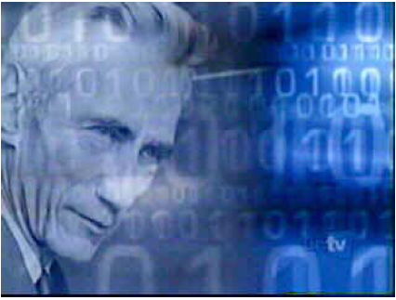
Father of Digital Communication
The roots of modern digital communication stem from the ground-breaking paper “A Mathematical Theory of Communication” by Claude Elwood Shannon in 1948.

Slide 3
Model of a Digital Communication System
Message
e.g. English symbols
Encoder
e.g. English to 0,1 sequence
Information
Source
Coding
Communication
Channel
Destination
Decoding
Can have noise
or distortion
Decoder
e.g. 0,1 sequence to English

Slide 4

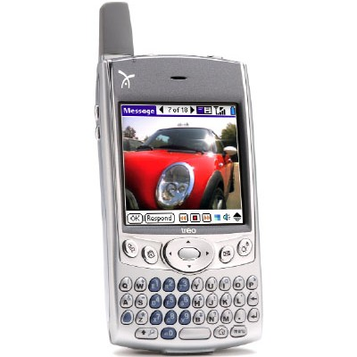
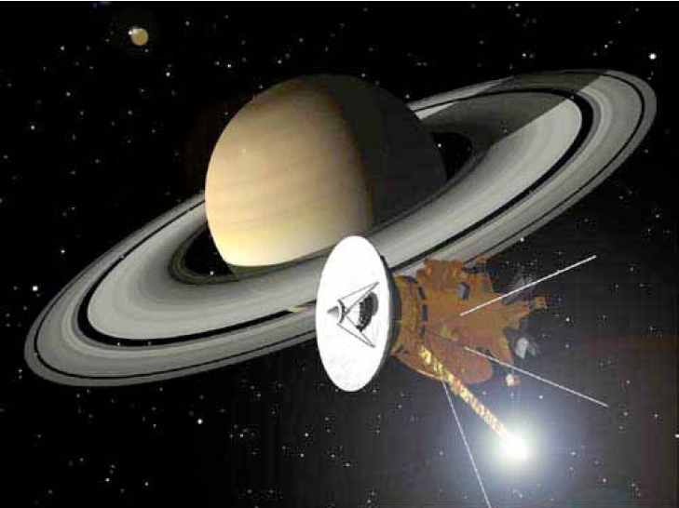
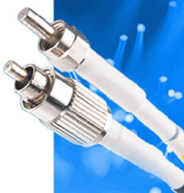

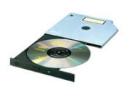
Communication Channel Includes

Slide 5
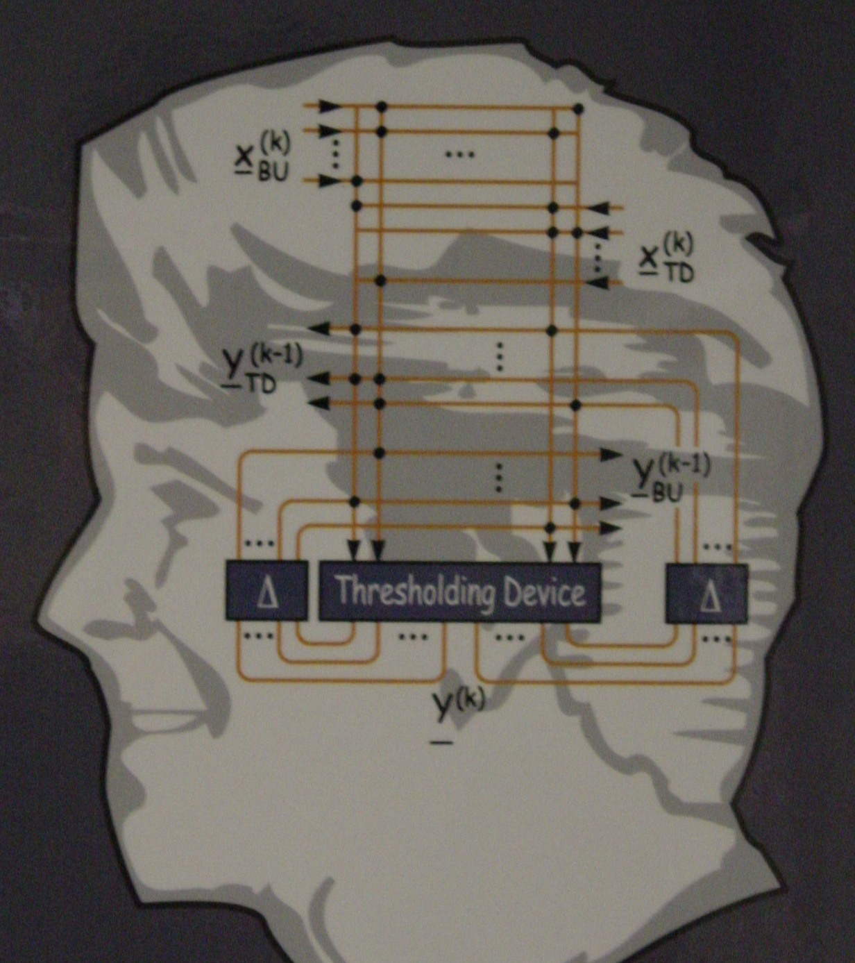
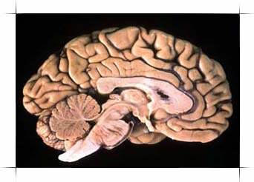
And even this…

Slide 6
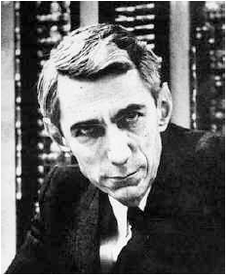
Shannon’s Definition of Communication
“The fundamental problem of communication is that of reproducing at one point either exactly or approximately a message selected at another point.”
“Frequently the messages have meaning”
“... [which is] irrelevant to the engineering problem.”

Slide 7
Shannon Wants to…
Shannon wants to find a way for “reliably” transmitting data throughout the channel at “maximal” possible rate.
Information
Source
Coding
Communication
Channel
Destination
Decoding
For example, maximizing the speed of ADSL @ your home

Slide 8
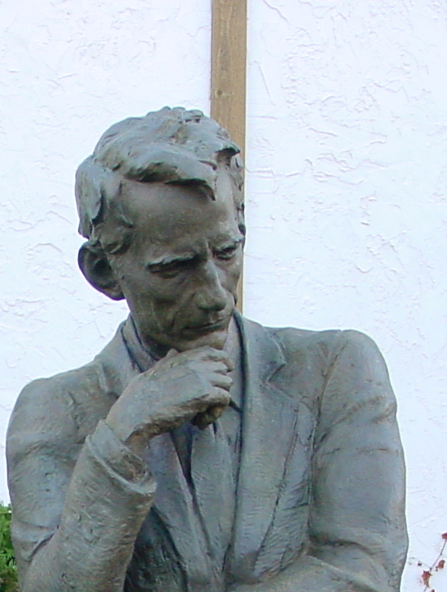
And he thought about this problem for a while…
He later on found a solution and published in this 1948 paper.

Slide 9
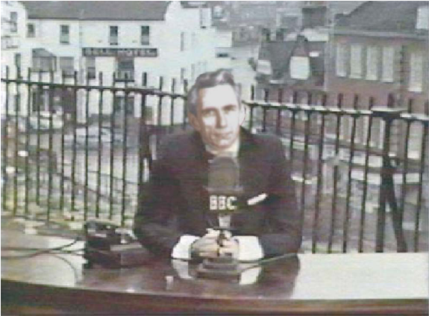
In his 1948 paper he build a rich theory to the problem of reliable communication, now called “Information Theory” or “The Shannon Theory” in honor of him.

Slide 10
Shannon’s Vision
Data
Source
Encoding
Channel Encoding
Channel
User
Source Decoding
Channel Decoding

Slide 11
Example: Disk Storage
Data
Zip
Add CRC
Channel
User
Unzip
Verify CRC

Slide 12
In terms of Information Theory Terminology
Zip
Source
Encoding
=
Data Compression
Unzip
Source Decoding
=
Data Decompression
Add CRC
Channel Encoding
=
Error Protection
Verify CRC
Channel Decoding
=
Error Correction

Slide 13
Example: VCD and DVD
Moive
MPEG
Encoder
RS Encoding
CD/DVD
TV
MPEG Decoder
RS Decoding
RS stands for Reed-Solomon Code.

Slide 14
Example: Cellular Phone
Speech Encoding
CC Encoding
Channel
Speech Decoding
CC Decoding
GSM/CDMA
CC stands for Convolutional Code.

Slide 15
Example: WLAN IEEE 802.11b
Data
Zip
CC Encoding
Channel
User
Unzip
CC Decoding
IEEE 802.11b
CC stands for Convolutional Code.

Slide 16
Shannon Theory
The original 1948 Shannon Theory contains:
Measurement of Information
Source Coding Theory
Channel Coding Theory

Slide 17

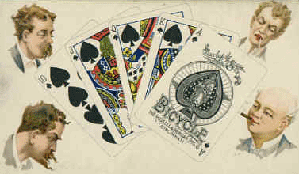
Measurement of Information
Shannon’s first question is
“How to measure information
in terms of bits?”
= ? bits
= ? bits

Slide 18
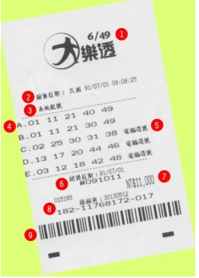

Or Lottery!?
= ? bits

Slide 19
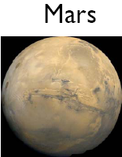
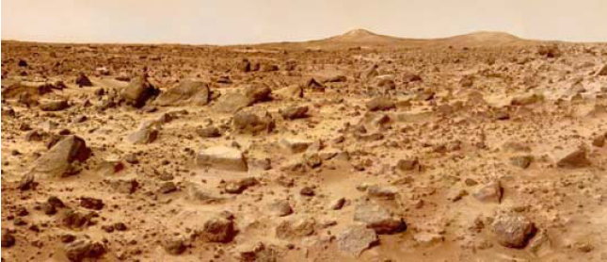
Or this…
= ? bits
= ? bits

Slide 20
All events are probabilistic!
Using Probability Theory, Shannon showed that there is only one way to measure information in terms of number of bits:
called the entropy function

Slide 21
For example
Tossing a dice:
Outcomes are 1,2,3,4,5,6
Each occurs at probability 1/6
Information provided by tossing a dice is

Slide 22
Wait! It is nonsense!
The number 2.585-bits is not an integer!!
What does you mean?

Slide 23
Shannon’s First Source Coding Theorem
Shannon showed:
“To reliably store the information generated by some random source X, you need no more/less than, on the average, H(X) bits for each outcome.”

Slide 24
Meaning:
If I toss a dice 1,000,000 times and record values from each trial
1,3,4,6,2,5,2,4,5,2,4,5,6,1,….
In principle, I need 3 bits for storing each outcome as 3 bits covers 1-8. So I need 3,000,000 bits for storing the information.
Using ASCII representation, computer needs 8 bits=1 byte for storing each outcome
The resulting file has size 8,000,000 bits

Slide 25
But Shannon said:
You only need 2.585 bits for storing each outcome.
So, the file can be compressed to yield size
2.585x1,000,000=2,585,000 bits
Optimal Compression Ratio is:

Slide 26

Let’s Do Some Test!
 | File Size | Compression Ratio
No Compression | 8,000,000 bits | 100%
Shannon | 2,585,000 bits | 32.31%
Winzip | 2,930,736 bits | 36.63%
WinRAR | 2,859,336 bits | 35.74%

Slide 27
The Winner is
I had mathematically claimed my victory 50 years ago!

Slide 28
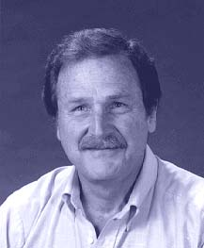
Follow-up Story
Later in 1952, David Huffman,
while was a graduate student in
MIT, presented a systematic
method to achieve the optimal
compression ratio guaranteed by
Shannon. The coding technique is therefore called “Huffman code” in honor of his achievement. Huffman codes are used in nearly every application that involves the compression and transmission of digital data, such as fax machines, modems, computer networks, and high-definition television (HDTV), to name a few.
(1925-1999)

Slide 29
So far… but how about?
How?
Done
Data
Source
Encoding
Channel Encoding
Channel
User
Source Decoding
Channel Decoding

Slide 30
The Simplest Case: Computer Network
Communications over computer network, ex. Internet
The major channel impairment herein is
Packet Loss

Slide 31
Binary Erasure Channel
Impairment like “packet loss” can be viewed as Erasures. Data that are erased mean they are lost during transmission…
1-p
0
0
p
Erasure
p
1
1
1-p
p is the packet loss rate in this network

Slide 32
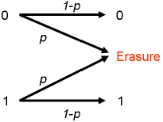
Once a binary symbol is erased,
it can not be recovered…
Ex:
Say, Alice sends 0,1,0,1,0,0 to Bob
But the network was so poor that Bob only received 0,?,0,?,0,0
So, Bob asked Alice to send again
Only this time he received 0,?,?,1,0,0
and Bob goes CRAZY!
What can Alice do?
What if Alice sends
0000,1111,0000,1111,0000,0000
Repeating each transmission four times!

Slide 33
What Good Can This Serve?
Now Alice sends 0000,1111,0000,1111,0000,0000
The only cases Bob can not read Alice are for example
????,1111,0000,1111,0000,0000
all the four symbols are erased.
But this happens at probability p⁴

Slide 34
Thus if the original network has packet loss rate p=0.25, by repeating each symbol 4 times, the resulting system has packet loss rate p⁴=0.00390625
But if the data rate in the original network is 8M bits per second
8Mbps
Alice
p=0.25
Bob
With repetition, Alice can only transmit at 2 M bps
8Mbps
2 Mbps
X 4
Alice
Bob
p=0.00390625

Slide 35
Shannon challenged:
Is repetition the best Alice can do?

Slide 36
And he thinks again…

Slide 37
Shannon’s Channel Coding Theorem
Shannon answered:
“Give me a channel and I can compute a quantity called capacity, C for that channel. Then reliable communication is possible only if your data rate stays below C.”

Slide 38
What does Shannon mean?
?
?
?
?

Slide 39
Shannon means
In this example:
8Mbps
p=0.25
Alice
Bob
He calculated the channel capacity
C=1-p=0.75
And there exists coding scheme such that:
8Mbps
?
8 x (1-p)
=6 Mbps
Alice
p=0
Bob

Slide 40
Unfortunately…
I do not know exactly HOW?
Neither do we… ☹

Slide 41
But With 50 Years of Hard Work
We have discovered a lot of good codes:
Hamming codes
Convolutional codes,
Concatenated codes,
Low density parity check (LDPC) codes
Reed-Muller codes
Reed-Solomon codes,
BCH codes,
Finite Geometry codes,
Cyclic codes,
Golay codes,
Goppa codes
Algebraic Geometry codes,
Turbo codes
Zig-Zag codes,
Accumulate codes and Product-accumulate codes,
…
We now come very close to the dream Shannon had 50 years ago! ☺

Slide 42

Nowadays…
Source Coding Theorem has applied to
Image
Compression
MPEG
Audio/Video
Compression
Data
Compression
Audio
Compression
MP3
Channel Coding Theorem has applied to
VCD/DVD – Reed-Solomon Codes
Wireless Communication – Convolutional Codes
Optical Communication – Reed-Solomon Codes
Computer Network – LT codes, Raptor Codes
Space Communication

Slide 43
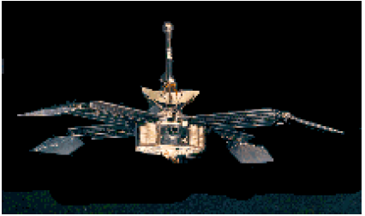
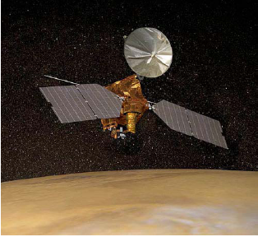
Shannon Theory also Enables Space Communication
In 1965, Mariner 4:
Frequency =2.3GHz (S Band)
Data Rate= 8.33 bps
No Source Coding
Repetition code (2 x)
In 2004, Mars Exploration Rovers:
Frequency =8.4 GHz (X Band)
Data Rate= 168K bps
12:1 lossy ICER compression
Concatenated Code

Slide 44
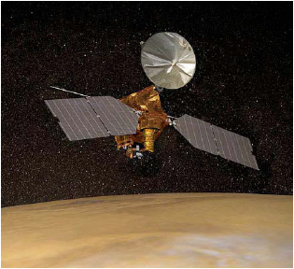
In 2006, Mars Reconnaissance Orbiter
Communicates
Faster than
Frequency =8.4 GHz (X Band)
Data Rate= 12 M bps
2:1 lossless FELICS compression
(8920,1/6) Turbo Code
At Distance 2.15 x 10⁸ Km

Slide 45
And Information Theory has Applied to
All kinds of Communications,
Stock Market, Economics
Game Theory and Gambling,
Quantum Physics,
Cryptography,
Biology and Genetics,
and many more…

